Slide 1


Digital Poultry Health Tracking – Power App Solution for
Organo Group

Slide 2

CONTENTS
1. Project Overview
2. Business Challenge
3. The Solution – Power App with Dataverse Integration
4. Business Impact
5. Technical Highlights
6. Strategic Value
7. Conclusion

Slide 3
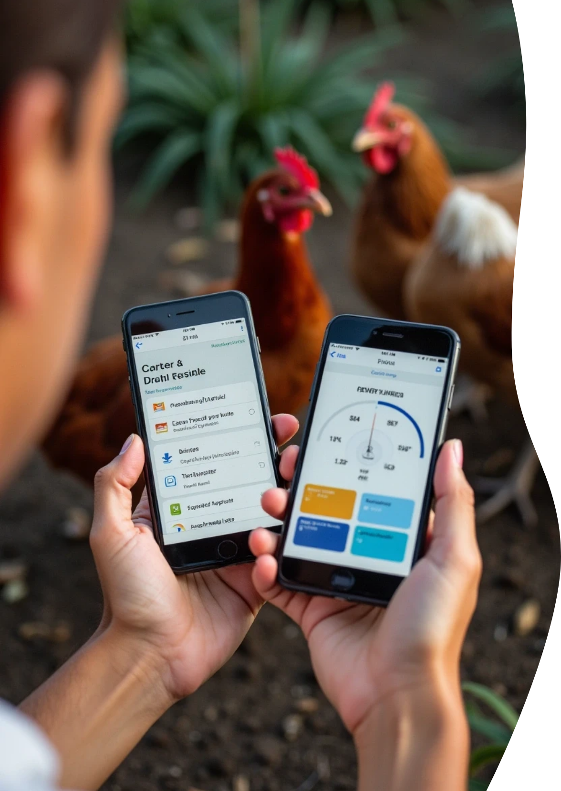
1. Project Overview
Key Message
A Power App developed to streamline poultry mortality and disease tracking, ensuring accurate, real-time health insights directly from farms.
Developed by
Aya Tarek – Data & Power Platform Developer

Slide 4
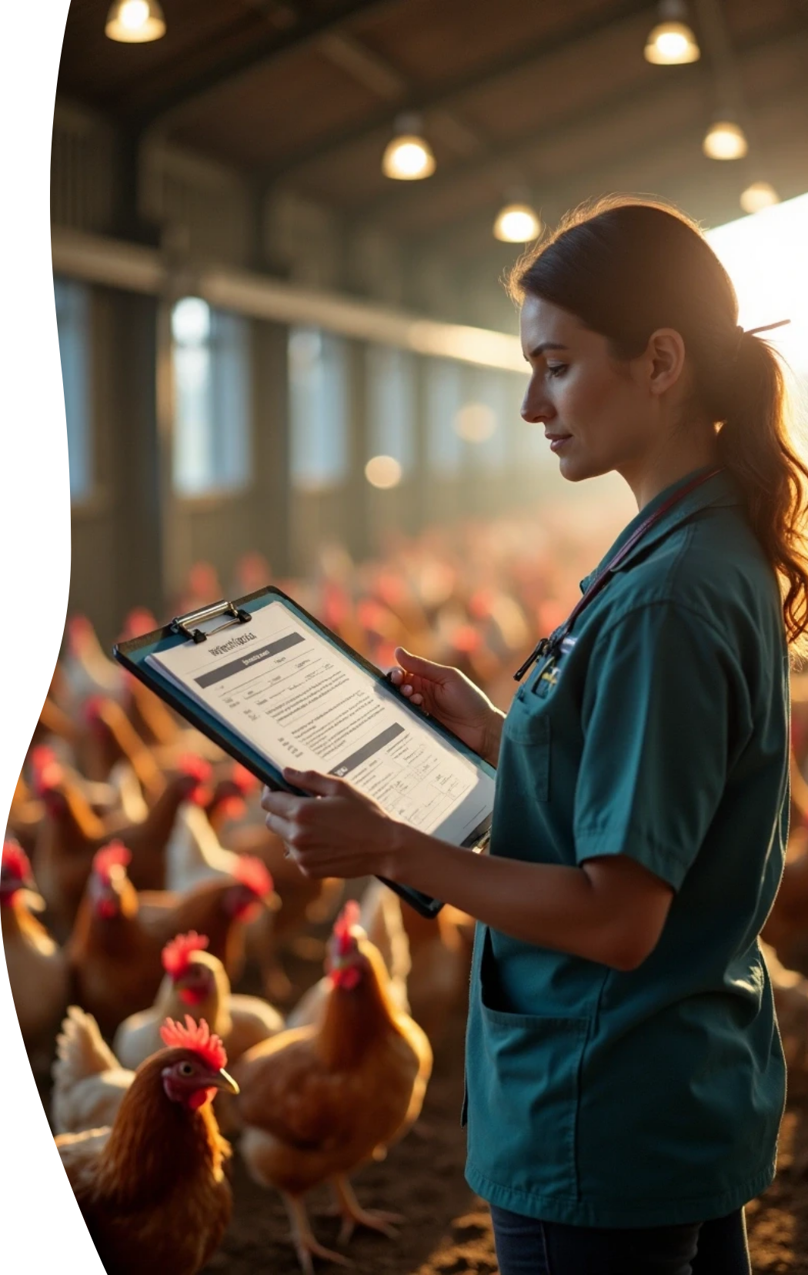
2. Business Challenge
Manual tracking of poultry deaths and diseases was time-consuming and error-prone.
Field staff relied on paper forms or Excel sheets, delaying decision-making.
Lack of centralized visibility made it difficult to detect health trends early.

Slide 5

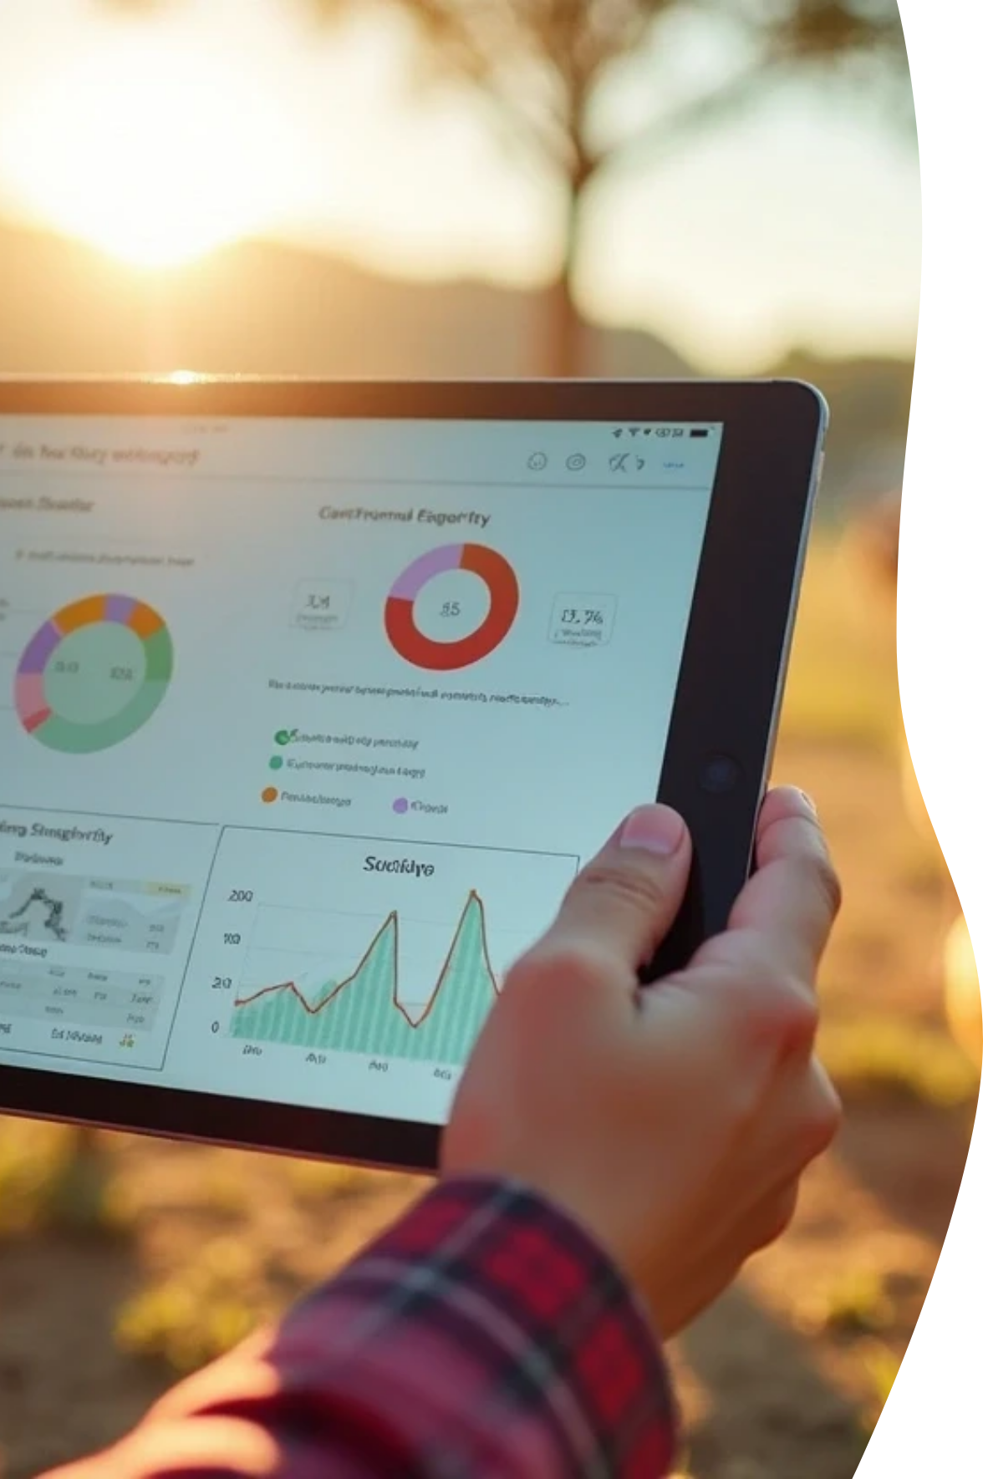
3. The Solution – Power App with Dataverse Integration
What I Built
A custom Power App allowing farm teams to record poultry deaths and diseases directly from mobile devices.
Data automatically stored in Microsoft Dataverse for instant synchronization.
Managers can view, edit, and validate all records via an interactive gallery view.

Slide 6


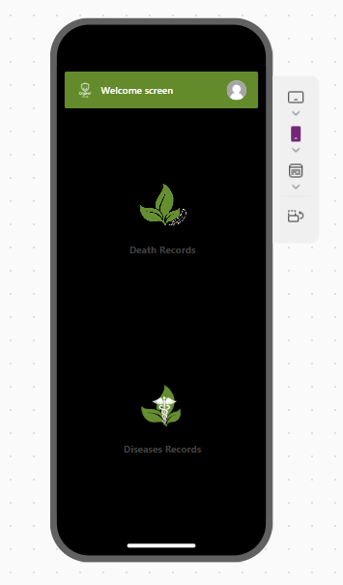
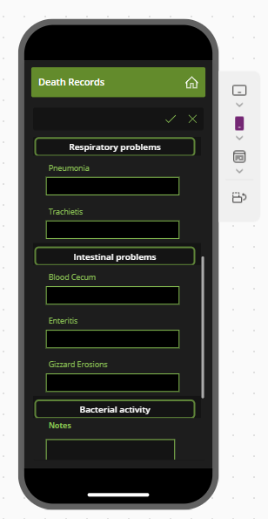
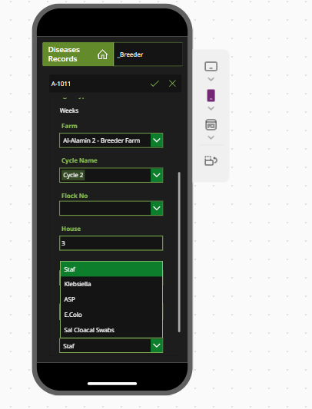
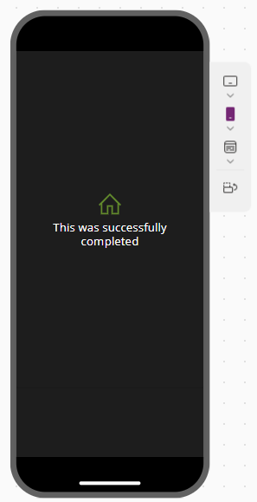
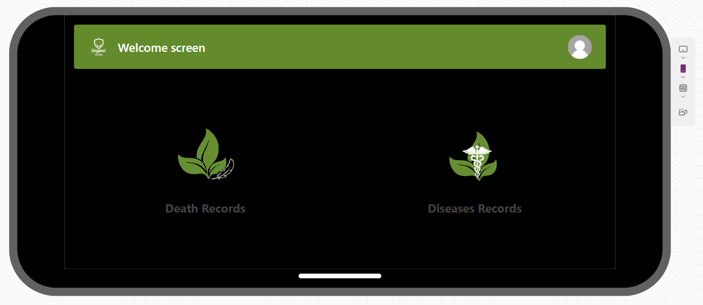
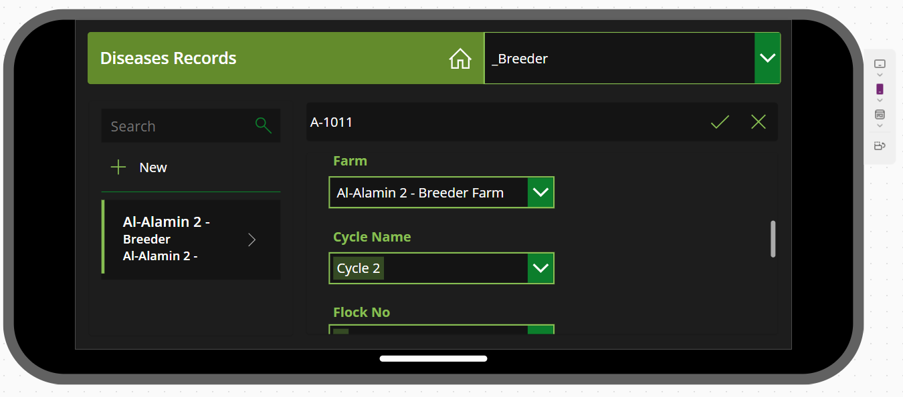
Key Components
Dynamic data-entry forms
Real-time data loading to Dataverse
Gallery screen for review and correction
Editable interface for fast data validation
Layout

Slide 7

4. Business Impact
Benefit Description | Details
⏱️ Real-time Data Flow | Farm data instantly available at HQ – no delays.
🧠 Improved Decision-Making | Early detection of disease patterns and mortality spikes.
✅ Data Accuracy | Reduced manual errors through structured input forms.
👥 User Empowerment | Staff can edit and manage records easily without IT intervention.
📊 Integration Ready | Centralized data in Dataverse enables Power BI dashboards and analytics.

Slide 8
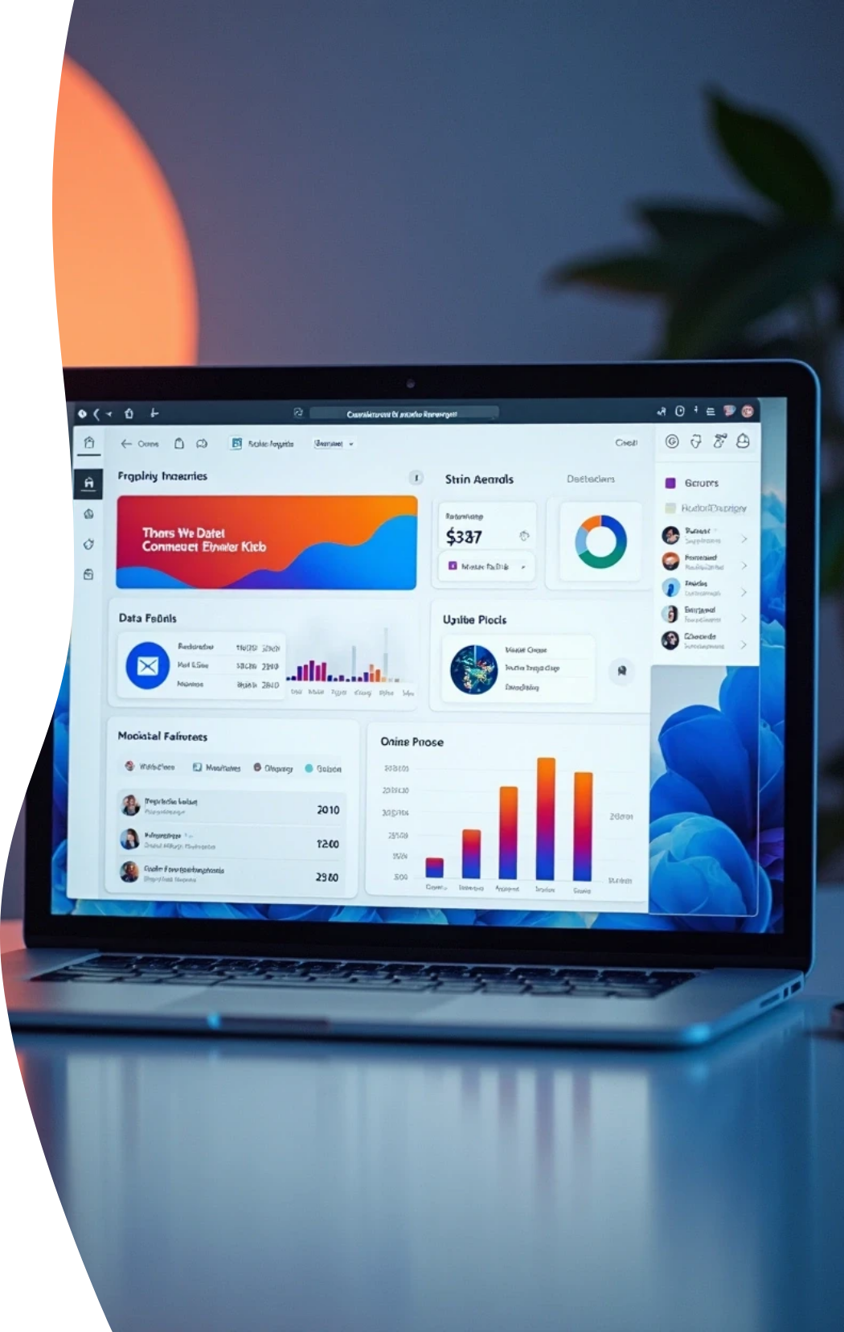
5. Technical Highlights
Platform: Microsoft Power Apps
Backend: Microsoft Dataverse

Slide 9




Features
1
2
Responsive forms for different poultry farms
Validation logic for data consistency
3
4
PowerFx formulas for automation
Gallery search & filter functionality
5
Secure role-based access

Slide 10
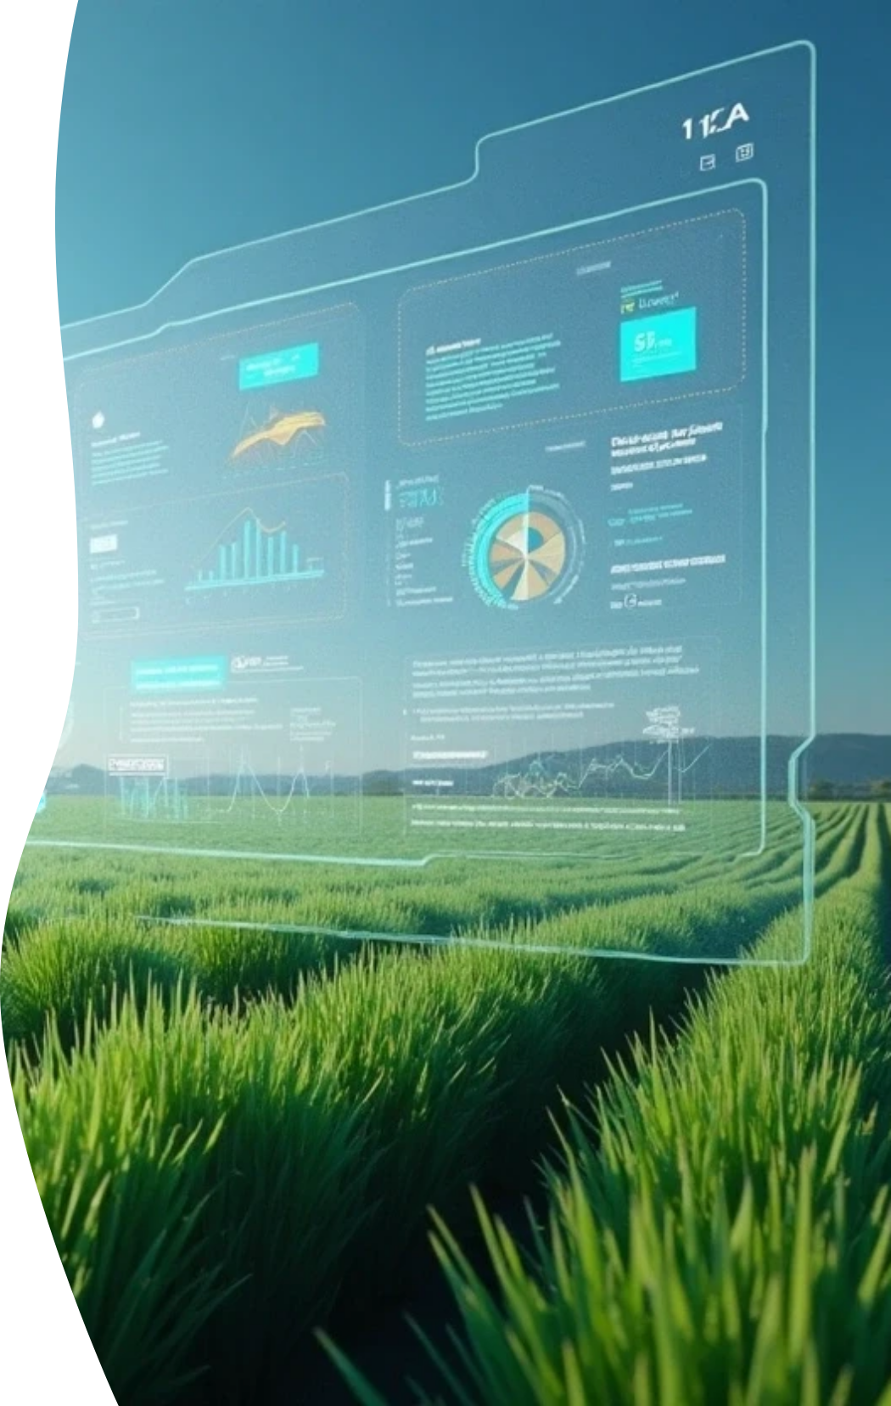
6. Strategic Value
Supports digital transformation and data-driven agriculture within Organo Group.
Sets the foundation for predictive analytics (e.g., mortality rate trends, disease risk modeling).
Scalable to include feed tracking, production performance, and vaccine data in future phases.

Slide 11

7. Conclusion
A single Power App that transformed manual poultry tracking into a smart, digital, and reliable process.
Empowering field teams. Accelerating decisions. Driving operational excellence.

Slide 12
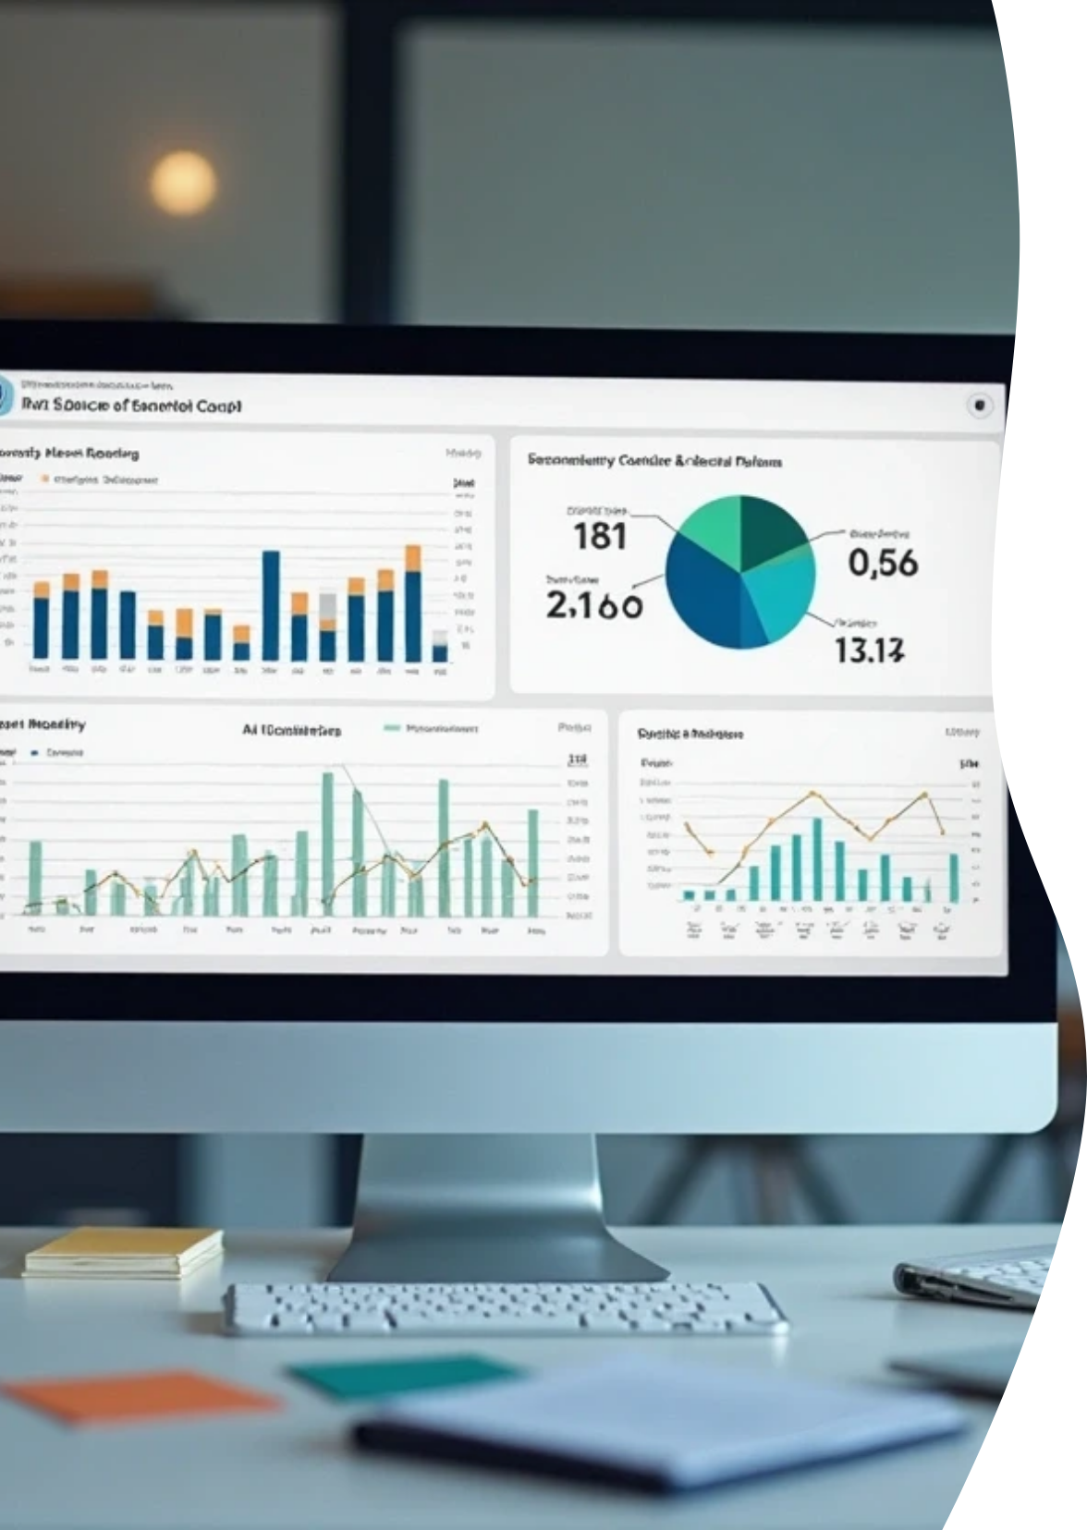

Next Steps
Expand app to include live reporting via Power BI
Automate alerts for mortality thresholds

Slide 13

Thank You

